Slide 1
Data Science Training
March 2022

Slide 2





Agenda
Data Science and Python Introduction
Data Preparation
Exploratory Data Analysis
Data Visualization
Feature Engineering & Selection
Supervised Learning
Neural Networks
Unsupervised Learning
Tuning, Validation & Testing
Final Exam

Slide 3
Data Science Training
Data Preparation
March 2022

Slide 4
Agenda
01
Unclean Data
02
Handling Missing Values
03
Untidy Data
04
Practice

Slide 5

What is Data Preparation?
“Data preparation is the process of collecting data from several data sources, and then profiling, cleansing, enriching, and combining those into a derived dataset for use in analytics process”
5

Slide 6
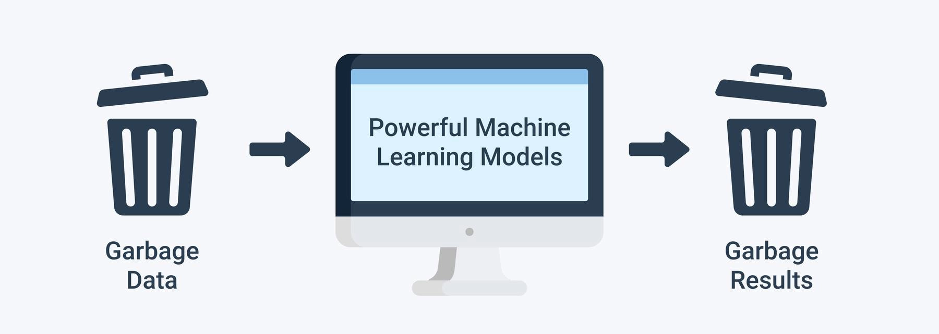
“Garbage in, garbage out”
Quality decisions must be based on quality data but real world data is dirty:
Data has not been collected for mining it
Typographical errors in nominal attributes, thus values need to be checked for consistency
Typographical and measurement errors in numeric attributes
Errors may be deliberate
6

Slide 7
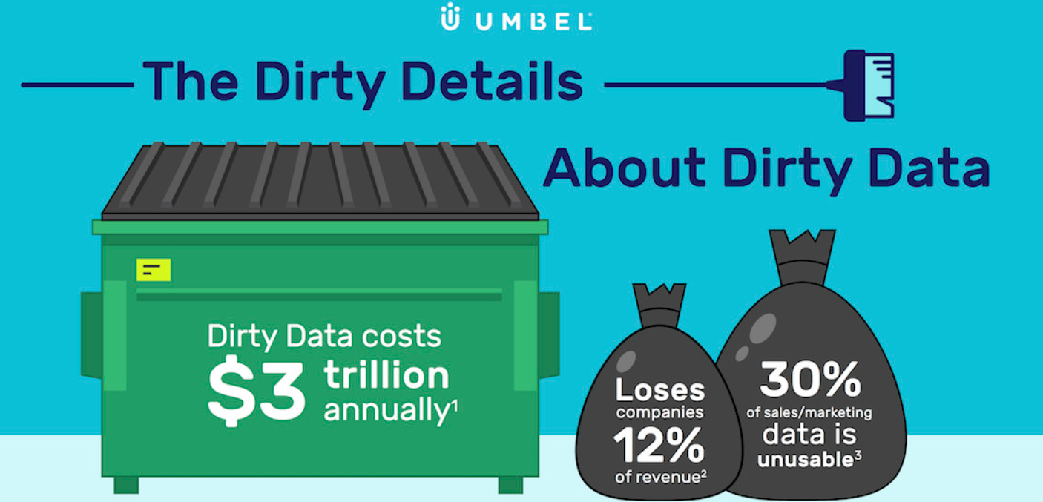
Dirty data are expensive

Slide 8
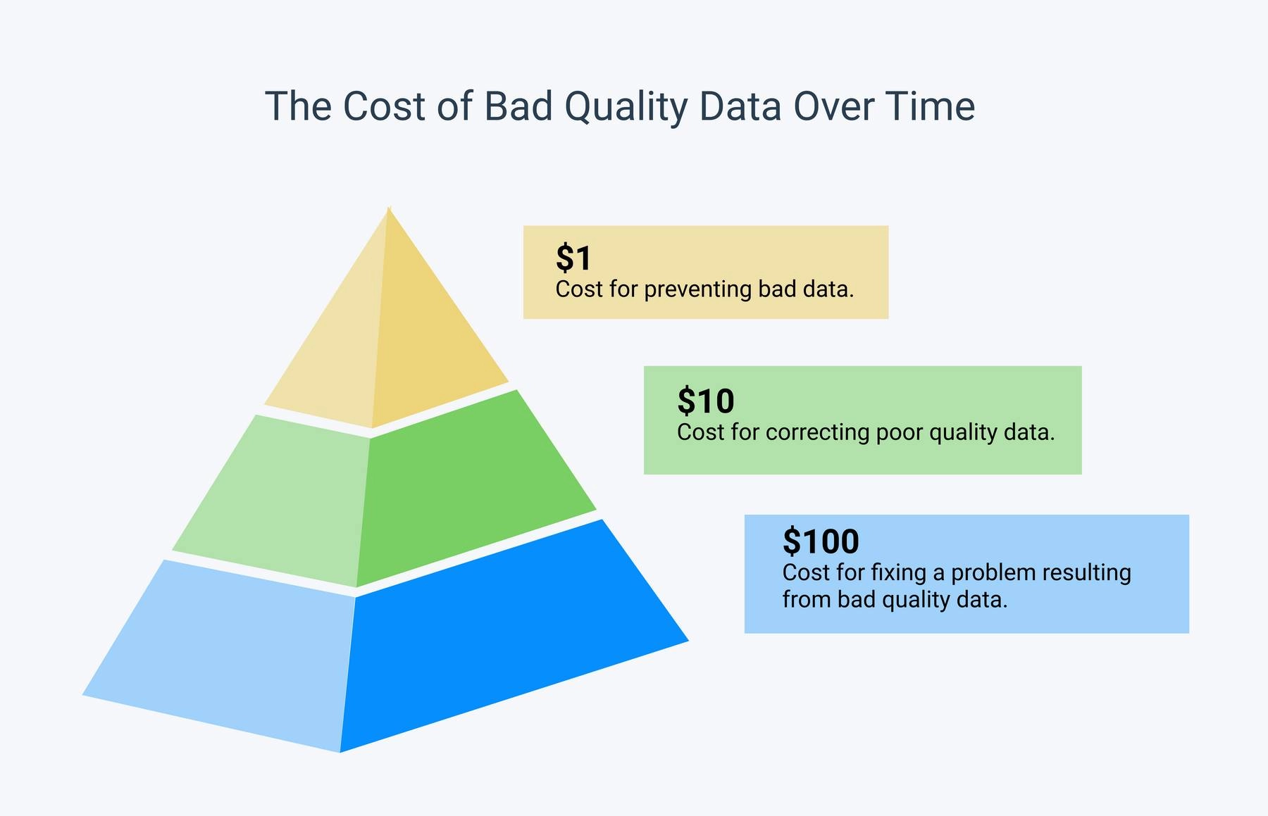
Dirty data are also expensive to fix

Slide 9
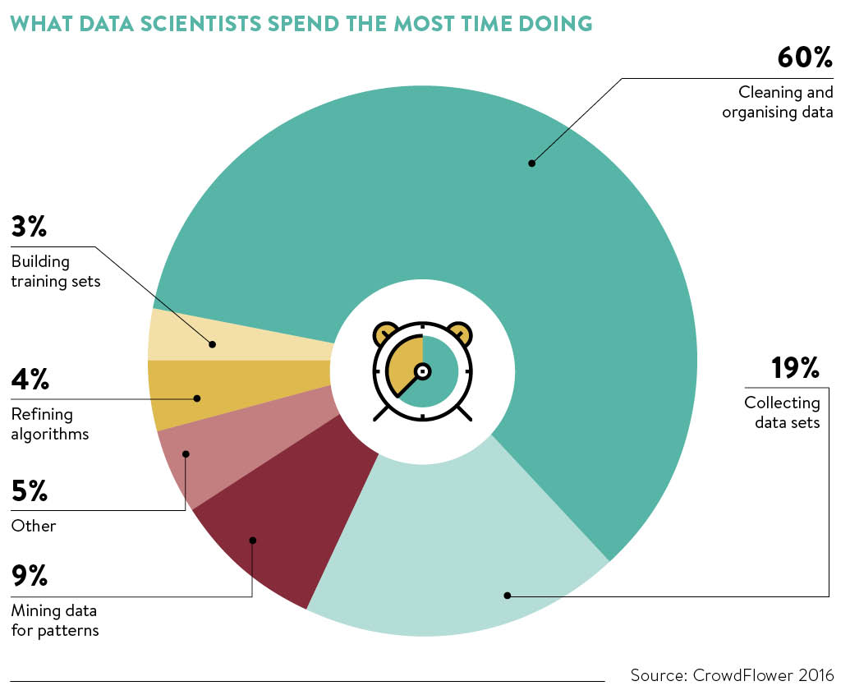
What Data Scientist spend the most time doing
Many people imagine a data scientist always involved in the implementation of advanced algorithms.
Instead, the preparation of the data is the phase that requires the most time of all.
Furthermore, it is also the phase that has the greatest impact on the final performance of the model: a very simple algorithm can make excellent predictions if the input data are well prepared.

Slide 10
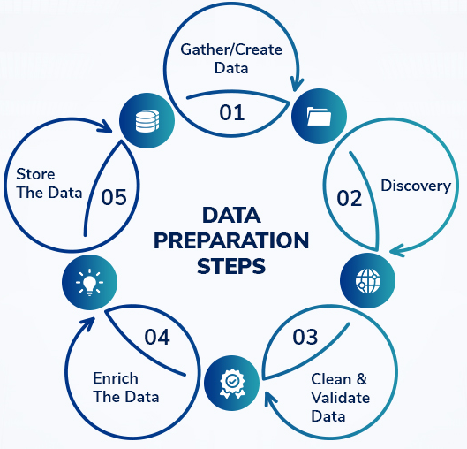
Data Preparation Steps
Tasks for each step:
01
Look for data sources
Combine data sources
Understand data sources
02
Observe data
Detect anomalies
Check data consistency
03
Handle missing values and outliers
Standardize/Normalize
De-duplicate
04
Transform features
Encoding
Binning

Slide 11
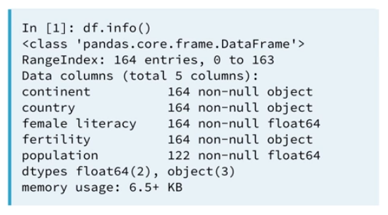
Cleaning data
First of all, visually inspect data. Look for:
Shape of the dataset (number of columns and rows), to verify what you are dealing with
Column names inconsistency (capital letters, symbols, different languages, etc.)
Number of non-null entries for each variable, to assess the number of missing values we have to handle
Metadata, to verify what data types you are dealing with (strings, floats, integers, categories, dates, etc.)
Example of data inspection
11

Slide 12



Data structuring and types conversion
Check the different types used to represent data (e.g. integers, floats, dates, times)
Convert to a common format throughout the database
Data transformation:
Rescaling
Dichotomization
Encoding
Number | Currency | Distance | Date | Missing
10000.0 | 1000.0 | 10000 cm | 20/11/91 | N/A
10,000.0 | €1000 | 0.1 km | 20NOV91 | ?
10000 | 1,000€ | 328 ft | 20-11-91 | .
“10000” | 1k€ | 100m | 11/20/91
10000 | 1000 | 100 | 20-11-91 | nan
12

Slide 13
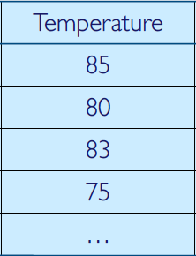
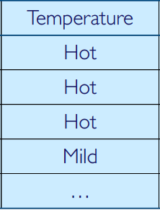
Attributes types
Numeric Attributes
Real-valued or integer-valued domain
Interval-scaled when only differences between values are meaningful (e.g. temperature)
Ratio-scaled when differences and ratios between values are meaningful (e.g. Age)
Not ordered and measured in fixed and equal units
Difference of two values makes sense
Sum or product may not make sense
Zero point is not necessarily defined
Can be discrete or continuous
Categorical (Nominal) Attributes
Set-valued domain composed of a set of symbols
Nominal when only equality is meaningful (e.g. domain(Sex) = {M, F} )
Ordinal when also inequality between values can be defined (e.g. domain(Education) = {High School, BS, MS, PhD})
Values are distinct symbols
Values themselves serve only as labels or names
Not necessarily ordered
No distance measure defined
13

Slide 14
Agenda
01
Unclean Data
02
Handling Missing Values
03
Untidy Data
04
Practice

Slide 15
Missing Values
In statistics, missing values occur when no data value is stored for the variable in an observation. Missing data are a common occurrence and can have a significant effect on the conclusions that can be drawn from the data.
Missing completely at random (MCAR)
Missing Completely at Random means there is no relationship between the missingness of the data and any values, observed or missing. There is nothing systematic going on that makes some data more likely to be missing than others.
Missing at random (MAR)
Missing at Random means there is a systematic relationship between the propensity of missing values and the observed data, but not the missing data. This means that the propensity for a data point to be missing is not related to the missing data, but it is related to some of the observed data
Not missing at random (NMAR)
Missing Not at Random means there is a relationship between the propensity of a value to be missing and its values.
Example: some survey questions contain a random sample of the whole questionnaire.
Example: whether or not someone answered #13 on your survey has nothing to do with the missing values, but it does have to do with the values of some other factor.
Example: respondents with high income less likely to report income.
Note that NMAR and MAR might be difficult to identify and often require domain knowledge
15

Slide 16
Dealing with Missing Values
Deletion methods (list-wise deletion)
Simplest approach
Only practical if there are few examples with missing values, otherwise, it can introduce bias
MCAR
Single imputation methods
mean/mode substitution – replace missing value with sample mean or mode
dummy variable control – create an indicator for missing value and impute missing values to a constant
regression imputation – replaces missing values with predicted score from a regression equation
These methods may increase the difficulty of the data mining process (introduction of bias, reduction of variability, etc.)
MCAR
MAR
Strategies
NMAR
Dig deeper ☺
For NMAR you need to go back to the source of the data to obtain more information
16

Slide 17
Agenda
01
Unclean Data
02
Handling Missing Values
03
Untidy Data
04
Practice

Slide 18
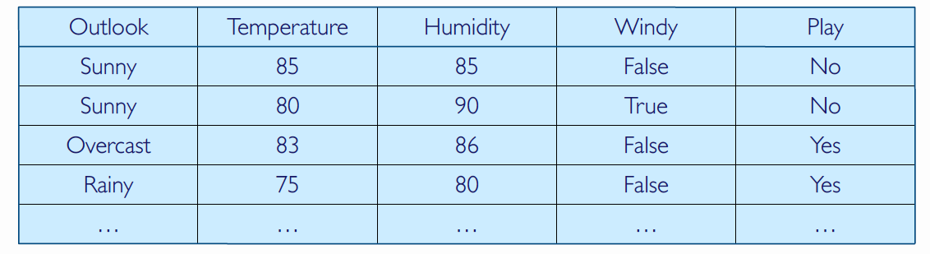
Tidy data
“Tidy” refers to the shape of data and formalize the structure data should have to ease analyses:
Columns represent separate variables
Rows represent individual observations
Observation (instance, case)
The atomic element of information from a dataset
Also known as record, prototype, or example
Variable
Measures aspects of an instance
Also known as feature or attribute
Each instance is composed of a certain number of attributes
18

Slide 19
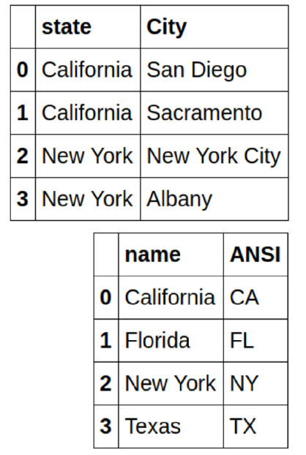
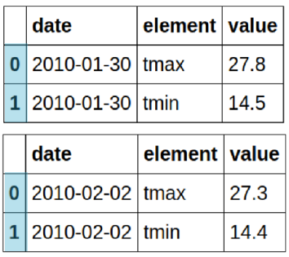
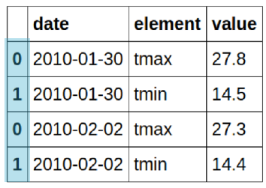
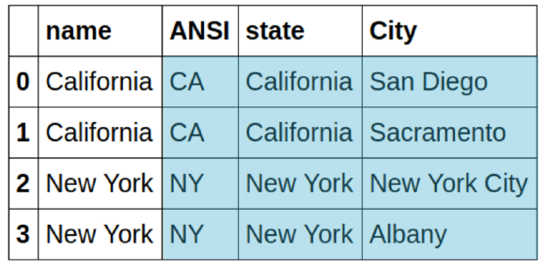
Combining data
Data do not always come in one single file:
Huge data sets may be broken into separate data sets, easier to store and share
May have new data every day
Different data sources
It is important to be able to combine different data sets. Combining includes concatenation and merging.
Concatenation
Merging
19

Slide 20
Duplicate entries
After combining different datasets, there may be duplicates that need to be removed. They can be columns or rows.
 | Name | ANSI | State | City
0 | California | CA | California | San Diego
1 | California | CA | California | Sacramento
2 | New York | NY | New York | New York City
3 | New York | NY | New York | Albany
 | Date | Element | Value
0 | 2010-01-30 | tmax | 27.8
1 | 2010-01-30 | tmin | 14.5
0 | 2010-02-02 | tmax | 27.3
1 | 2010-02-02 | tmin | 14.4
2 | 2010-01-30 | tmax | 27.8
3 | 2010-01-30 | tmin | 14.5
 | Date | Element | Value
0 | 2010-01-30 | tmax | 27.8
1 | 2010-01-30 | tmin | 14.5
0 | 2010-02-02 | tmax | 27.3
1 | 2010-02-02 | tmin | 14.4
 | ANSI | State | City
0 | CA | California | San Diego
1 | CA | California | Sacramento
2 | NY | New York | New York City
3 | NY | New York | Albany
20

Slide 21
Agenda
01
Introduction to
Data Science
02
Python Installation Guide
03
Basics of Python
04
Practice

Slide 22
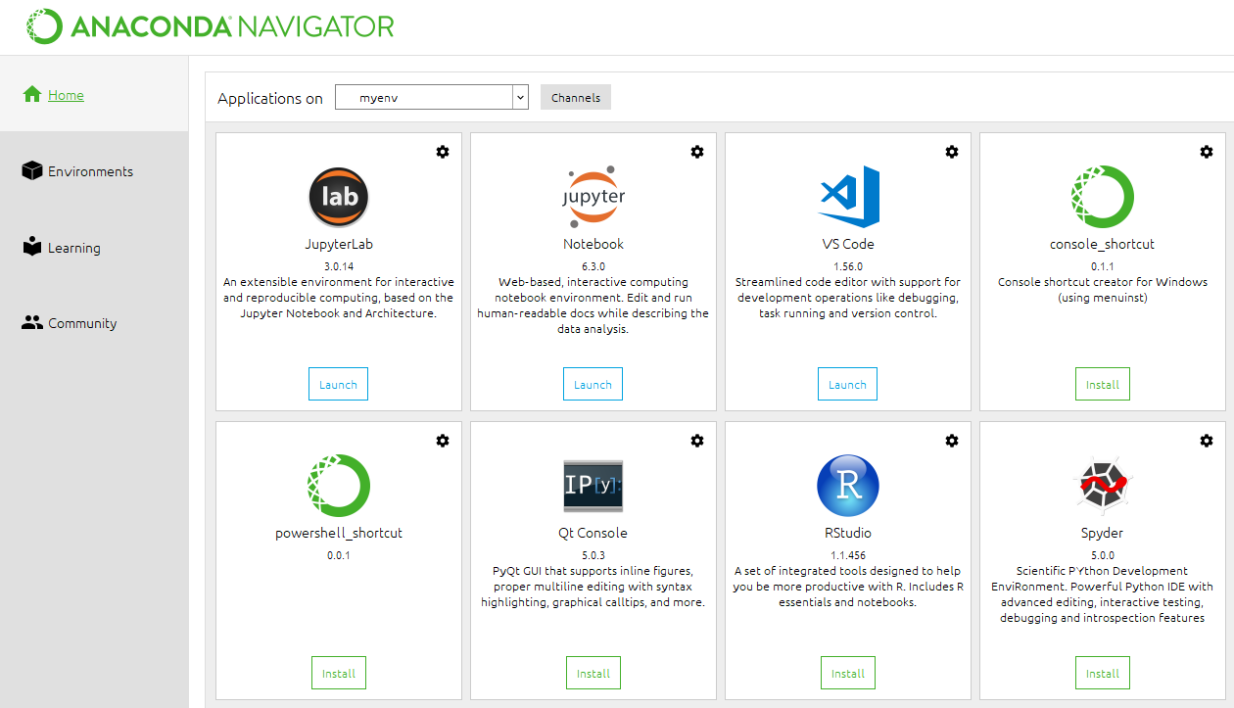
Launch Jupyter Notebook through Anaconda Navigator
Open Windows search bar again and run Anaconda Navigator. Once the application has started, launch Jupyter Notebook.
22

Slide 23
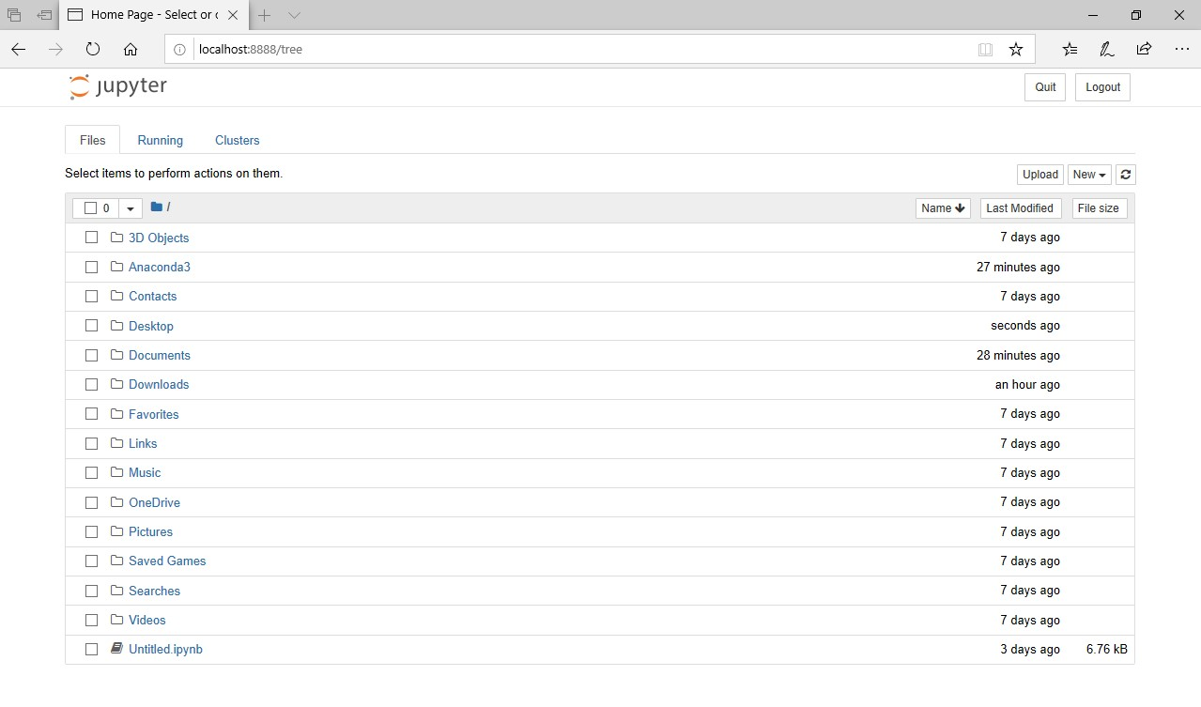
Open ► Day 2 - Data Preparation.ipynb
If you see a browser page as the example below, Jupyter Notebook is correctly running on the machine.
23

